Slide 1
Long-term planning and the effects of the European Common Currency on economic development of a country
Raivo Vare
Head of the supervisory council of the Estonian Development Fund
Riga 24.11.2011

Slide 2
The case
Based on Estonian case to show, how principal decisions, once made and maintained long enough, are making difference and bring success, but shall not be considered as final and need to be revisited and developed

Slide 3
Estonia as a case – preconditions 1
Size matters - small country, rapid reactions
Open economy model & exports orientation
High share of FDI
Currency board
Yet low-cost-economy
Geopolitically challenged – difference in approaching euro
Public mentality advantage

Slide 4
Estonia as a case – preconditions 2
Public sector low debt and budget surplus, kept constantly by all governements + accumulation of state reserves
Late arrival of (over)borrowing wave
Participation in the chain of global exports of capital goods to Asia through target export markets - Finland and Sweden
Pure luck
– inflation criteria momentum because of the crisis + absence of the Governement bonds and respective criteria reference
- Scandinavian influence, especially in FDI and banking
- political usefulness of acceptance of EE to eurozone on a larger scale at the very peak of the crisis as a good example

Slide 5
Some decisions with long-term implications 1
EEK pegged to DEM 8:1 right from the beginnning – 1992
Cleaning of the commercial banking sector – 1992-1997 in the very harsh way
Flat taxation – 1993
Privatization by Treuhandt model – 1993-1998
State budget surplus 1994-2007 (except 1999) – formation of reserves
New commercial and civil legislation – 1991-1995

Slide 6
Some decisions with long-term implications 2
Principal decision to join EU – 1996-97 and fulfillment of aquis communitaire
Waiving of tax on the re-invested profits – 2000
Internal devaluation and substantial austerity program (which continues) during the crisis to preserve the currency board and enter the eurozone -2009
etc. etc.
=> All these and numerous other decisions have paved the way for Estonia to join finally the eurozone

Slide 7
EURO!
Positive:
EE as small country, slim and fit, pretty competitive, geographically well positioned, accustomed to live by means available not wishes disireable => speedy adjustment and recovery
EE has founded its place in international division of labor
34th in the world ranking of HDI
Influx of FDI enabled by euro - new wave of first of all from Scandinavian neighbourhood

Slide 8
EURO?
But: when we arrived the party, it was almost over and the time comes to pay the bill
Uncertainty about not only eurozone but even EU as such
Development of two-speed Europe and EE’s placement in this process?
Lagging behind the core states has become apparently visible
High dependancy ratio on FDI and exports jeopardised by the eurocrisis
Influence of deleveraging on businesses and demand
=> How to catch up? => Need for longterm efforts and respective planning

Slide 9
Challenges ahead
Eurozone break-up or preservation -> planning for both with the recognition of the need for the continuation of the present austerity policies
In any case – some waver of the sovereignity is ahead in relation to crisis prevention, management and resolution mechanism for fiscal and financial sustainability whether the “core zone” or the wider one (e.g. to European supervisory institution, European deposit insurance corp. , European banking resolution authority)
Preparing for lesser and more precisely targeted EU support money influx -> especially important for planning of infrastructure development

Slide 10
Disadvantages of the periphery
Main disadvantage – geographical distance
Solution: intensive transport connections and respective development of the infrastructure
Infrastructure planning and construction – very longterm process and requires especially careful and effective approach
Regional specifics: physical infrastructure is a mutual problem for all 3B and Poland, requireing common approach (RailBaltic, ViaBaltica, SSS etc. – is it there?

Slide 11
Vision for growth
Estonian Development Foundation with extensive participation of 1000 different people has developed the Growth Vision 2018
The work was facilitated by 4 scenarios
The excercise was to develop some ideas how to catch up the core of Europe and be successful in the new circumstances
The main starting point
– new times demand new approaches as the previous success is not a guarantee for the future advancement;
- EURO helps, but not guarantees success (Greek or Portugal case)
- regional co-ordinated development is a key factor
Main suprise: only 3 out of 9 main key goals and aspirations are pure economical ones. The rest are related to so called soft areas!

Slide 12
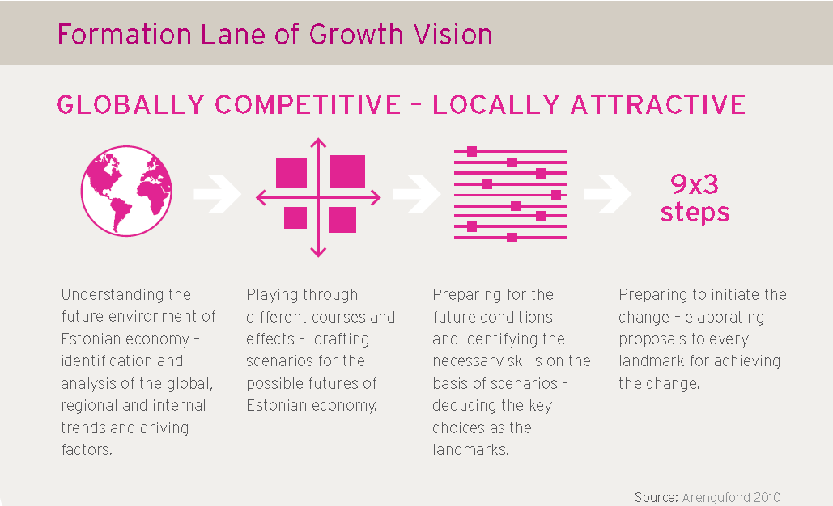

Slide 13
Strong recovery from the crisis and favorable export conditions
Hanseatic League II
Skype Island
(best option for protectionist development case)
(outbound and collaborative)
Fragmented
Weak
Harmonious
Strong
Economic Climate in Estonia’s External Markets
Degree of Baltic Rim Regional Cooperation
State Returns
Southern Finland
(inward orientation)
(present situation)
Painful recovery from the crisis and tense export conditions

Slide 14
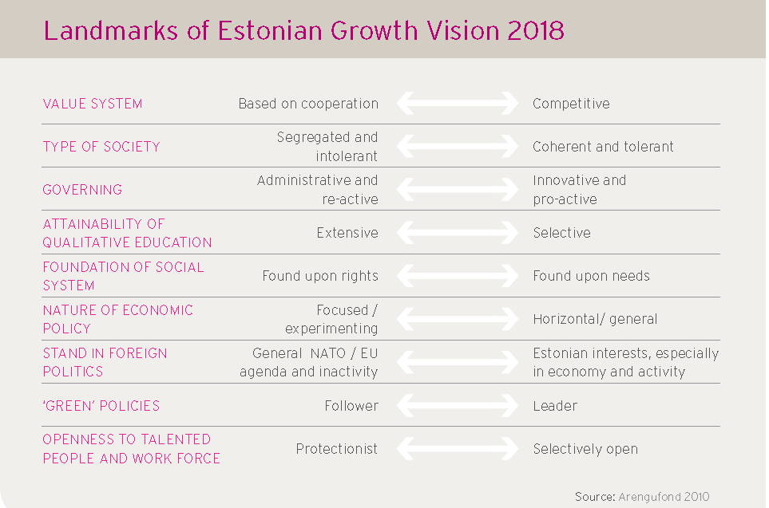

Slide 15
Problems of planning
Present planning is mainly linear (e.g. EU 2020, state budgeting (3Y strategy and annual), majority of the businesses)
Doing slightly more doesn’t make a difference in quality improvement we need -> switch to landmark-based prioritised and focused policy on the state level
Constant scenario update is must
Plan B is ultimate prerequisite in turbulent times like now

Slide 16
Problems of planning
Plan without vision is not an option for a small state, but vision without proper planning and execution is doomed (like eurocrisis has perfectly shown)
Regional co-operation is immanent, but difficult to achieve on macro level (e.g. Baltic common infrastructure projects like Visiginas, RB, LNG), although good examples even during the crisis (Banking support deal between Swedish and Baltic Central Banks)
Quality leap requires a reset in planning for the longer perspective and smart focusing on priorities
EURO doesn’t make a big difference, but sets more influential framework environment for planning at all levels

