Slide 1
Latvian Economy: development scenarios and challenges
Ilmārs Rimšēvičs
Bank of Latvia Governor
Riga, November 2011

Slide 2
Latvia successfully recovered from the crisis, we predict this year’s GDP growth at 4.8%
GDP growth, %
* - GDP forecast according to forecast base scenario

Slide 3
In the third quarter, GDP growth remained high
GDP growth (%)

Slide 4
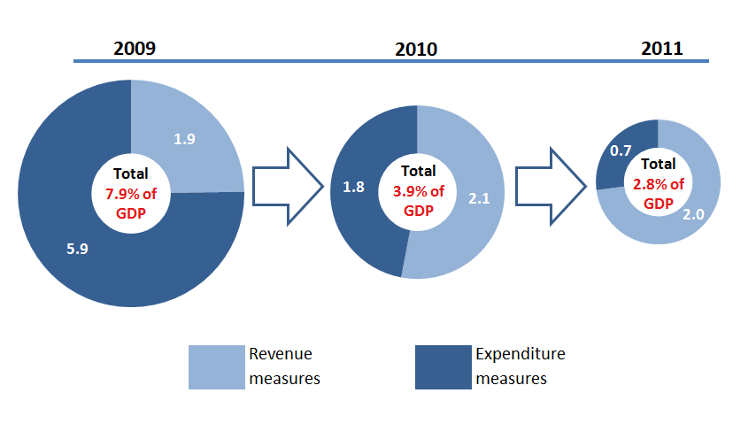
Latvia has already implemented sizable fiscal consolidation
Breakdown of budget consolidation measures, % of GDP

Slide 5
Latvia has quickly regained its cost competitiveness: wage-productivity gap has narrowed considerably
Real hourly wage and labour productivity per hour (2005 Q1 = 100, seasonally adjusted)

Slide 6
Competitiveness and export growth fostered recovery; countries with fixed exchange rate are European leaders in terms of export growth
Goods exports in 2010, % y/y

Slide 7
With economic recovery, unemployment has dropped. Employment growing in almost all branches
Registered unemployment, %

Slide 8
Global economic prospects are unfortunately beginning to deteriorate; growth predictions for Latvia’s main trading partners are being reduced substantially
GDP forecast for euro area in 2012, % (JP Morgan, time axis- moment of making forecast)

Slide 9
The European Commission has admitted: recession – a drop in production and services volumes possible.
On10 November, Commissioner Oli Rehn warned of possible“repeated recession" in Europe, when announcing the EC forecasts for EU countries, which point to an expected drop in growth.
“The future outlook is unfortunately gloomy. This forecast is the last wake-up call. The recovery in the EU has come to a standstill and there is a risk of a new recession unless decisive measures are taken.”

Slide 10
The resolution of the European debt crisis will not be fast, speculations and fluctuations in the financial markets will continue
*highlighted=non-compliance with Maastricht criteria; data source: European Commission (forecasts accordingly unchanged as per political scenario)

Slide 11
Recent experience shows: those countries that manage to straighten their finances are more successful in staying above the water
GDP annual growth rate; 2nd quarter, %

Slide 12
Still much to do to straighten out state finances: budget deficit implies higher interest payments and increased debt
General Government debt and interest payments (EKS’95 methodology)
* Bank of Latvia forecast, ** along with FISIM

Slide 13
In a short time, Latvia has become a country with a debt burden
Total debt of state and local governments (% of GDP, ESA’95 methodology)

Slide 14
Total expenditure of state consolidated general budget is higher than in 2007
p - predicted

Slide 15
Latvia’s credit ratings are low!
That means: fewer jobs, higher interest payments
Standard&Poor’s rating agency’s long-term currency liability rating
A+
A+
A–
BBB+
BBB+
BBB–
BB+
BB+
BB–

Slide 16
What do low credit ratings mean for the public sector?
Schedule of central government debt repayment by nominal, mil.lats

Slide 17
If euro is not introduced and credit ratings are not improved, it may cost the budget an additional billion lats in interest payments in the next 10 years
Additional annual interest payments if euro not introduced and borrowing and refinancing the debt in the financial market, mil. lats
In 10 years, we will overpay by almost 1 billion LVL

Slide 18
What do low credit ratings mean for the private sector?
Further drop in lending and limited opportunities to finance new investments
Loans to domestic businesses and households, annual growth rate (%)

Slide 19
State budget will be the decisive factor that will determine future development of the economy
Determining clear steps towards the balanced budget
Adopting the Fiscal Responsibility Law

Slide 20
In 2012, budget deficit must be under 2.5% and continue to shrink in subsequent years
Maximum permitted budget deficit (accg to ESA’95) levels, to stop the excessive deficit procedure instigated against Latvia (will substantially improve confidence in state finances; a precondition for meeting the Maastricht criterion):
  in 2012 – 2.5% of GDP
  in 2013 – 1% of GDP
  in 2014 – balanced budget

Slide 21

Budget must be consolidated independently of euro introduction plans. Yet euro changeover would be an additional advantage
Budget balance (% of GDP)
EURO
Budget strategy
Measure

Slide 22
We are predicting that inflation in 2013 will approach the Maastricht criterion. Yet if negative risks materialize, inflation may exceed the criteria
Forecast of inflation and Maastricht criterion, %
Countries with the lowest inflation in EU
 | 2011 |  | 2012 |  | 2013 III
Evaluation of Maastricht criterion | 3.0 |  | 2.4 |  | 2.4
1st place | IE | 1.1 | IE | 0.7 | GR | 0.8
2nd place | SE | 1.5 | GR | 0.8 | IE | 0.8
3rd place | CZ | 1.8 | ES | 1.1 | ES | 1.2
* EC autumn forecast BoL calculations

Slide 23
It must be noted that “the window of opportunity” for euro introduction may very possibly be shut after 2014
Inflation and Maastricht inflation criterion, %
Notes:
23

Slide 24
